Slide 1
Predicting Property Prices in New York City
Group 2 - Fredrick Jones, Jian Quan Chen, Tilon Bobb

Slide 2
Abstract
This study uses real estate transaction data to investigate the factors influencing property values in New York City (NYC). The dataset includes a variety of parameters that were gathered from public records and real estate listings, including property location, kind, size, and sale price. To understand the distribution and interrelationships of the dataset, exploratory data analysis (EDA) is the first systematic stage in the study technique. Data preparation is a step that comes next in order to encode categorical variables, handle missing values, and create new features. Stepwise regression, generalized linear models (GLM), robust regression, and conventional linear regression are all included in the design of regression models. The goal of developing predictive models that offer robustness against outliers while generalizing effectively to new data is achieved through the use of goodness-of-fit measures and diagnostic tests for residual analysis as the basis for model selection.

Slide 3
Introduction
The New York real estate market is one of the most dynamic and influential sectors of urban development
Motivation: Identify the factors that influence NYC real estate prices
Goal: Create a model that predicts NYC real estate prices
Data Source: New York City’s (NYC) Department of Finance Property Sales
Contains real estate transactions from the five boroughs of New York
Contains 20 years of data from 2003 to 2023
The dataset we are analyzing contains 21 columns and 1,603,826 rows
The response variable will be the Sale Price of the property

Slide 4
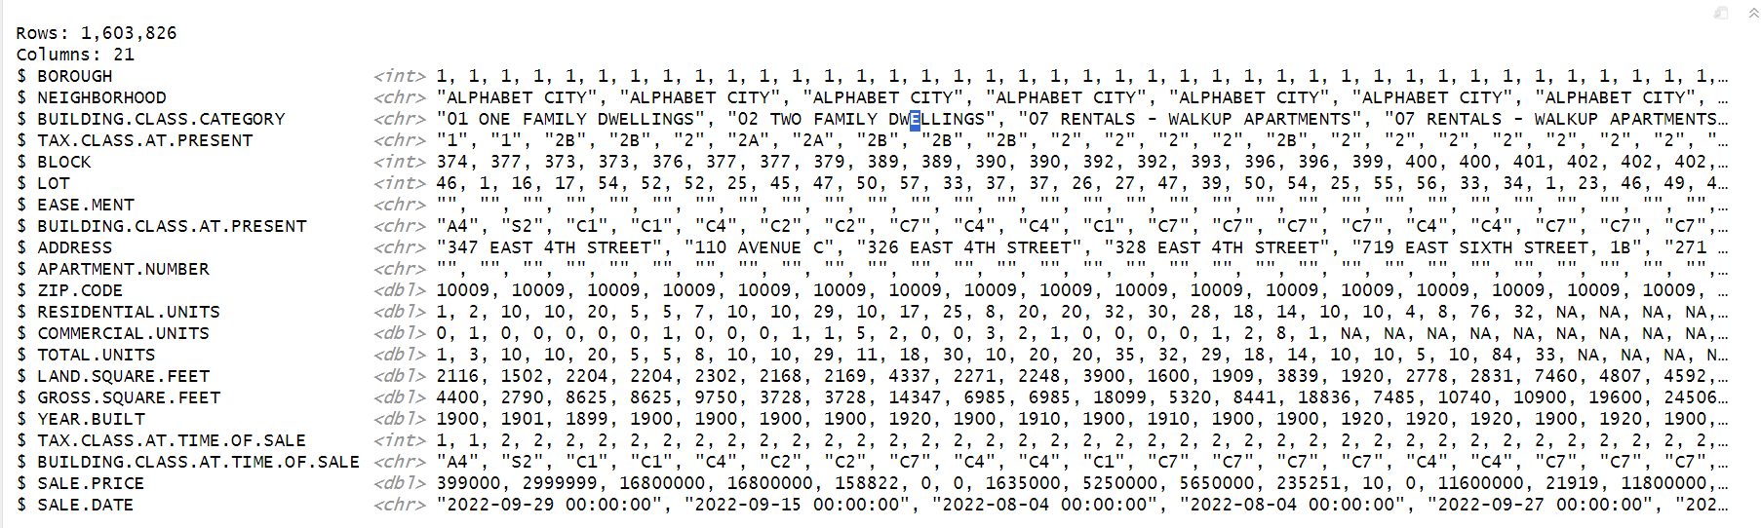
Glimpse of the Data

Slide 5
Methodology
Exploratory Data Analysis (EDA) & Data Preparation
Identify columns with missing values
There were 9 columns with missing values
The missing values represented less than 5% of the total observations
Dropped ALL missing values
Distribution Plots of the numeric variables
Identifying and removing outliers using the Interquartile range method
Correlation Analysis
Property values over time

Slide 6
Methodology
Regression Modeling
Use regression modeling to forecast real estate prices in New York City
Build linear regression models using different predictor variables
Predictor variables were selected based on their impact on the real estate prices
Linear models were chosen here because they provide a simple and interpretable relationship between the features and the continuous target variable
Used a train/test (80/20) split strategy to train and evaluate our linear model
Performance measured by Mean Squared Error (MSE),R-squared value, Akaike information criterion (AIC)

Slide 7
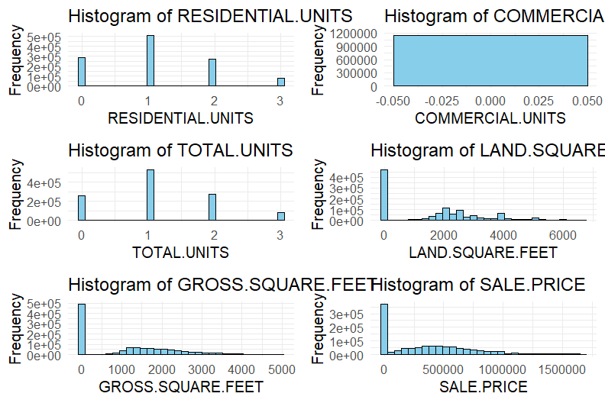
Distribution Plot
Notes:
These variables seem to be right skewed

Slide 8
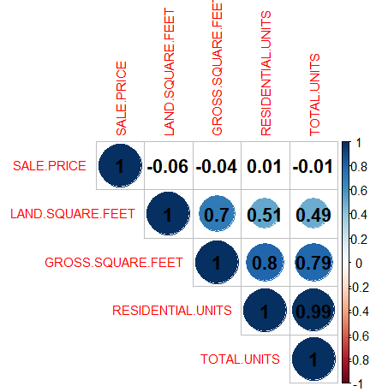
Correlation Plot
There is a strong positive correlation between gross square feet and land square feet, as well as between residential units and total units.
Sale price has a weak or slightly negative correlation with most of the other variables, suggesting that higher sale prices may not necessarily be associated with larger property sizes or more units.

Slide 9
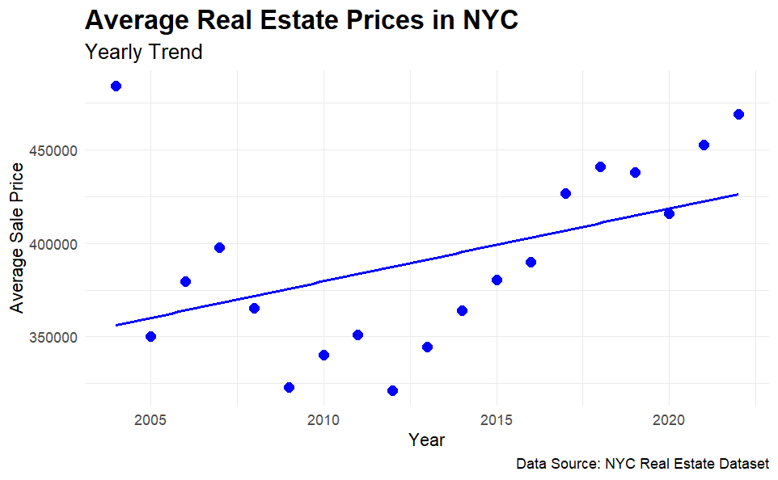
Real Estate Prices Over Time

Slide 10
Experimentation and Results

Slide 11
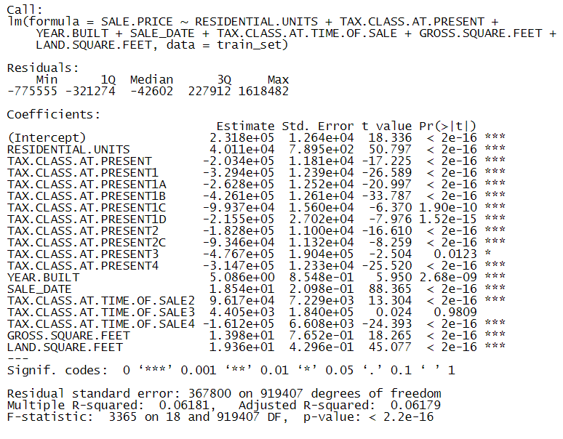
Linear Model
The linear regression model suggests that various factors significantly influence real estate prices in New York City
Notably, residential units, tax class, year built, sale date, tax class at time of sale, gross square feet, and land square feet all demonstrate statistically significant relationships with sale prices
However, the model's adjusted R-squared value of 0.06181 indicates that only about 6.164% of the variability in sale prices is explained by these factors

Slide 12
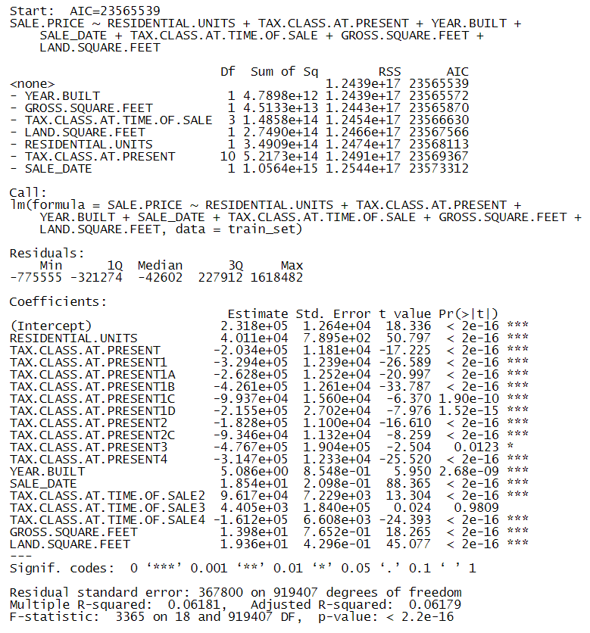
Stepwise Model
AIC of 23565539
Stepwise regression process selected a final model with predictors including residential units, tax class, year built, sale date, tax class at the time of sale, gross square feet, and land square feet
This model reveals statistically significant relationships between these predictors and sale prices, as indicated by the low p-values and the coefficients' significance levels
The adjusted R-squared value remains low at 0.06164

Slide 13
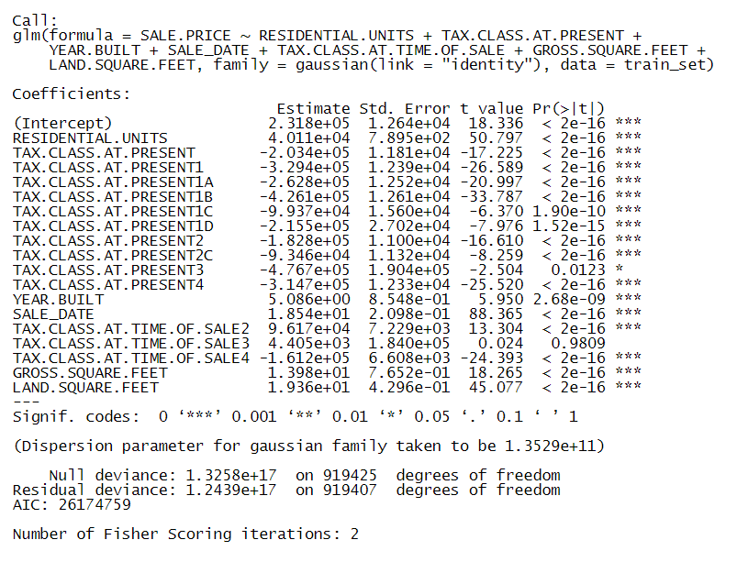
Generalized Linear Model (GLM)
Fit GLM with different error distribution and link function
The coefficients and their significance remain consistent with the previous models
The null and residual deviances provide additional information on the goodness of fit, with the residual deviance being slightly lower than the null deviance, suggesting some level of model improvement

Slide 14
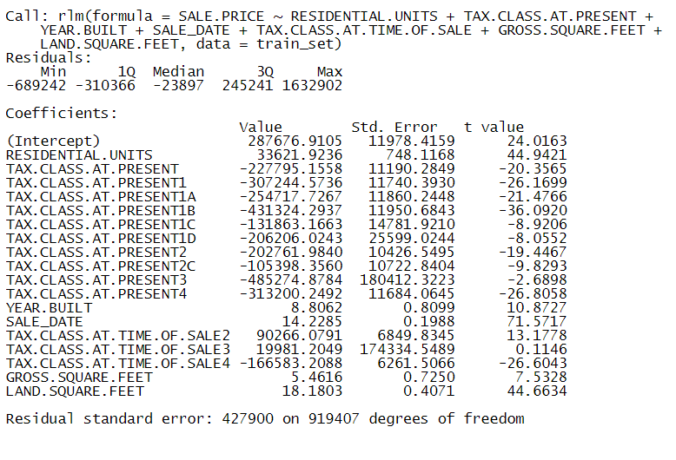
Robust Linear Model (RLM)
Each additional residential unit increases the sale price by $33,621.92
For the tax class at present, each category shows significant negative impacts on the sale price, with Tax Class 1B having the largest effect, reducing the price by $431,324.29
A one-unit increase in the year built is associated with a $8.8062 increase in sale price
Each day increment in the sale date adds $14.22 to the sale price
Gross square feet and land square feet, also exhibit significant positive effects on the sale price

Slide 15
Robust Linear Model (RLM)
Do the coefficients make sense?
Yes, the positive coefficient for RESIDENTIAL.UNITS suggests that properties with more residential units tend to have higher sale prices
Yes, the negative coefficients for the different TAX.CLASS.AT.PRESENT variables suggest that the tax class of a property at the time of sale can negatively impact its sale price
Yes, the positive coefficient for YEAR.BUILT indicates that newer properties tend to sell for more than older properties
Yes GROSS.SQUARE.FEET and LAND.SQUARE.FEET variables also have positive coefficients, suggesting that larger properties are higher in prices, which aligns with general real estate market expectations

Slide 16
Model Evaluation
Model | R Squared | RSE | AIC
Linear Model | 0.06100972 | 368458.6 | 26174759
Stepwise Model | 0.06100972 | 368458.6 | 26174759
GLM | 0.06100972 | 368458.6 | 26174759
RLM | 0.0565965 | 369328.7 | 26179144
In terms of performance, the linear, stepwise Regression, and GLM models all achieved an R-squared value of approximately 0.061, a RSE of 368458.6, and an AIC of 26174759
The RLM performed worse of the linear models with a R-squared of 0.0566, a RSE of 369328.7, and an AIC of 26179144
Given these results, the linear Regression, stepwise Regression, or GLM model can be recommended as models to predict property prices in NYC

Slide 17
Discussion and Conclusion
Our exploration revealed that a multitude of factors, including the number of residential units, the tax class, the year of construction, the date of sale, the tax class at the time of sale, the gross square footage, and the land square footage, all wield a statistically significant influence over real estate prices in the bustling metropolis of New York City
However, the adjusted R-squared values of our models suggested that these factors collectively only explained about 6.1% of the variability in sale prices
This finding suggests that there are other influential predictors that are currently not included in our models
In terms of performance on the test data, the linear model, stepwise model, and GLM all demonstrated similar efficacy, with an R-squared value of approximately 0.061 and a RSE of 368458.6

Slide 18
Discussion and Conclusion
The robust linear model, exhibited a slightly lower R-squared value of 0.057, suggesting it might be marginally less effective at explaining the variance in the target variable compared to the other models
Limitations:
Relatively low R-squared values
Exclusion of certain economic factors such as mortgage rates
Did not include location data as it was categorical
Looking ahead, we recommend exploring other potential predictors and considering the use of other types of models, such as non-linear models, to enhance the predictive power of our analysis
Our models provide some insights into the factors influencing real estate prices in New York City.
The low R-squared values in our model show that these variables represent only a small portion in this complex problem of real estate prices.
While our current models have their limitations, they represent a good starting towards a more comprehensive understanding of real estate prices.

Slide 19
References
DataScienceDonut. (2024). Current NYC Property Sales. Kaggle. Retrieved April 24, 2024, from https://www.kaggle.com/datasets/datasciencedonut/current-nyc-property-sales
Gaynor, M. (2022). Analysis of NYC Property Sales. Medium. Retrieved April 24, 2024, from https://medium.com/@mgaynor228/analysis-of-nyc-property-sales-9af7686aa2ca

